Slide 1

Football Player Performance Analysis
A comprehensive data analytics project examining performance metrics across leagues and identifying key efficiency drivers
Prepared By: Jayadev H | Focus: Performance Analytics

Slide 2
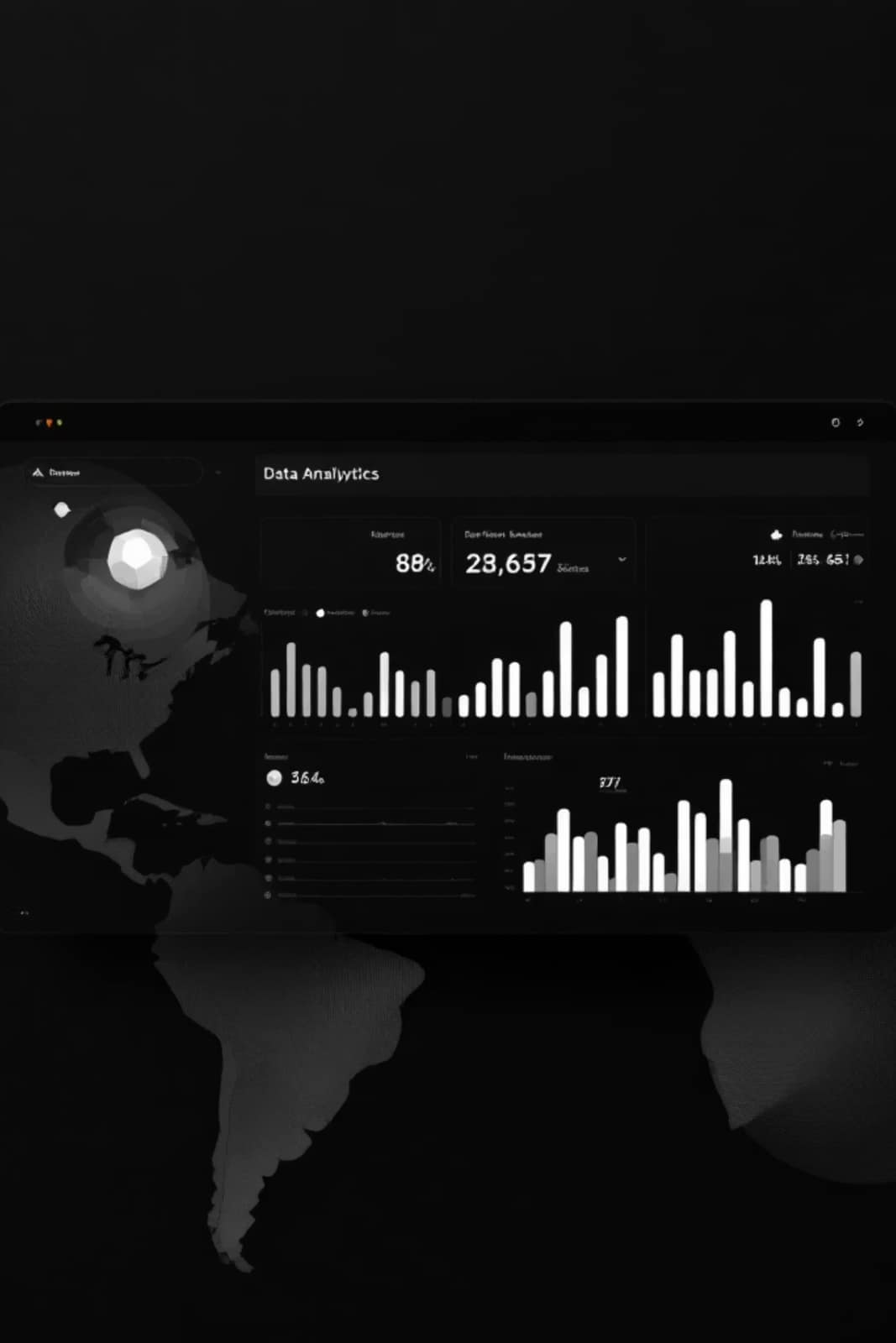
Executive Summary
Objective
Approach
Analyze football player performance using statistical methods and data visualization to identify key performance drivers
Systematic data cleaning, exploratory data analysis, and visual analytics to extract meaningful patterns
Outcome
Identified performance trends, efficiency metrics, and actionable insights for player evaluation

Slide 3

Problem Statement
Primary Questions
How do key metrics (goals, assists, matches) relate to overall player efficiency?
What patterns emerge in goal-scoring behavior across different players?
How does performance vary between teams and leagues?
Which derived metrics best predict success?

Slide 4

Dataset Overview
1000
15
5
Player Records
Variables
League Types
Complete season data
Performance metrics
Domestic and international
The dataset includes player demographics, team affiliations, league information, and comprehensive performance statistics. Data spans both categorical (team, league, position) and numerical (goals, assists, matches played, minutes) variables.

Slide 5



Data Preparation Process
Data Quality Check
Missing Values
Derived Metrics
Identified and removed duplicate player entries across multiple sources
Applied mean imputation for numerical fields and mode for categorical data
Created Goals per Match ratio and shooting accuracy percentage

Slide 6

Key Analysis Performed
Top Performers
Ranked players by total goals and efficiency metrics to identify elite performers
Statistical Distribution
Analyzed goal distribution patterns and identified outliers in scoring behavior
Correlation Analysis
Examined relationship between goals and assists to understand scoring patterns
League Comparison
Compared performance across different leagues to identify competitive advantages

Slide 7
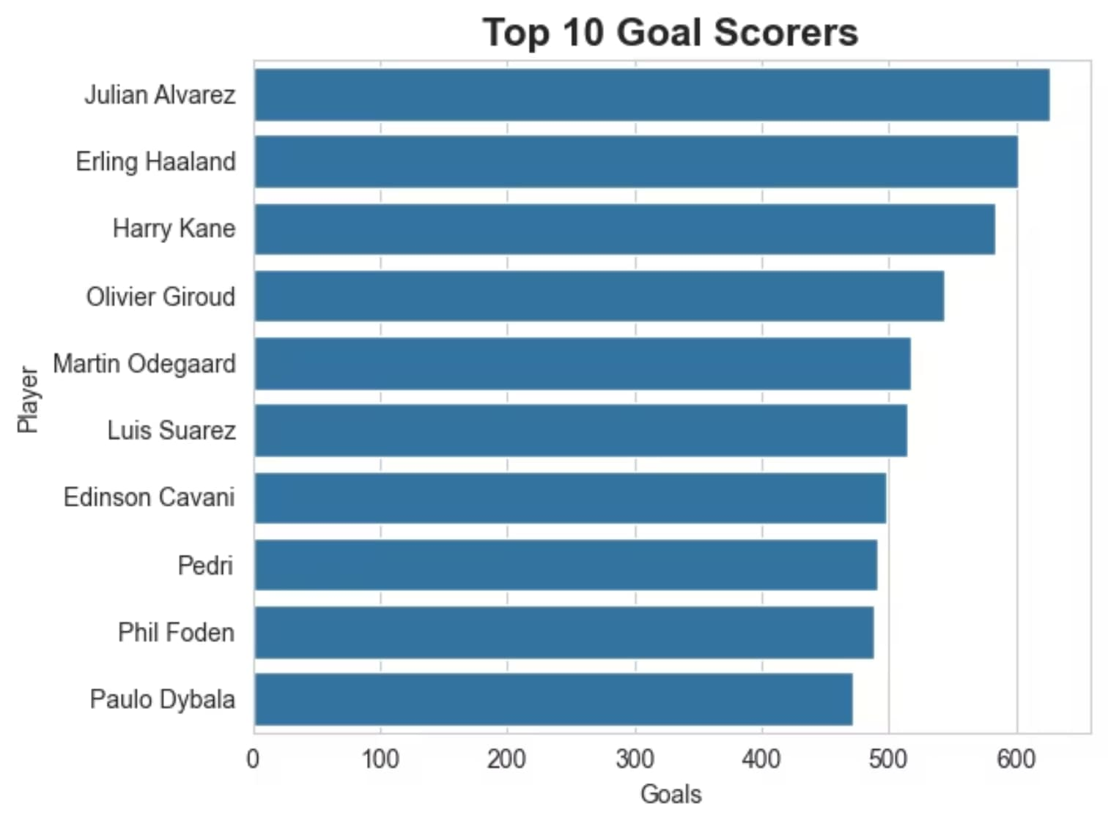

Top Performers Analysis
The Top 10 Goal Scorers chart reveals the elite performers in our dataset. Julian Alvarez leads with over 600 goals, followed by Erling Haaland and Harry Kane. This visualization directly supports our 'Top Performers' analysis, showing the concentration of scoring talent among elite strikers.

Slide 8
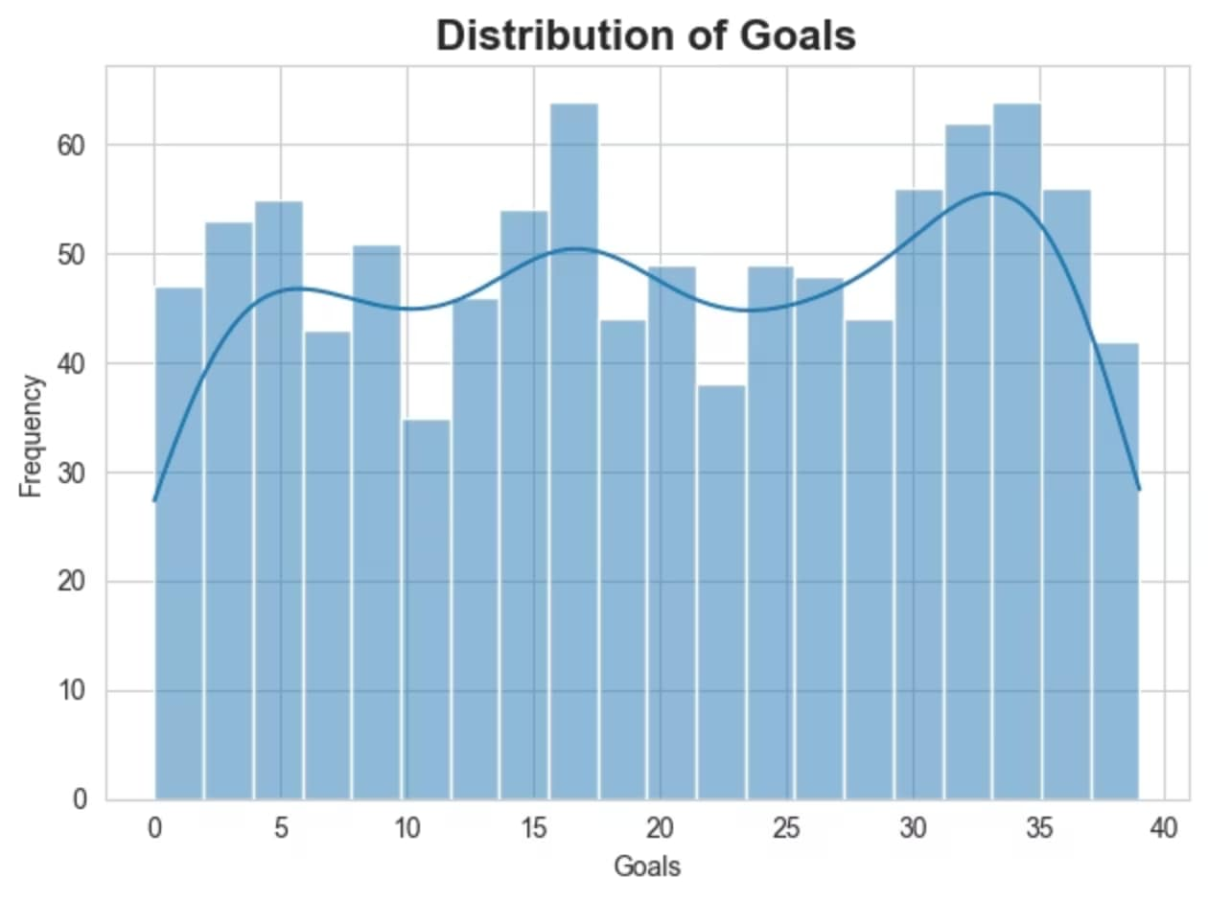
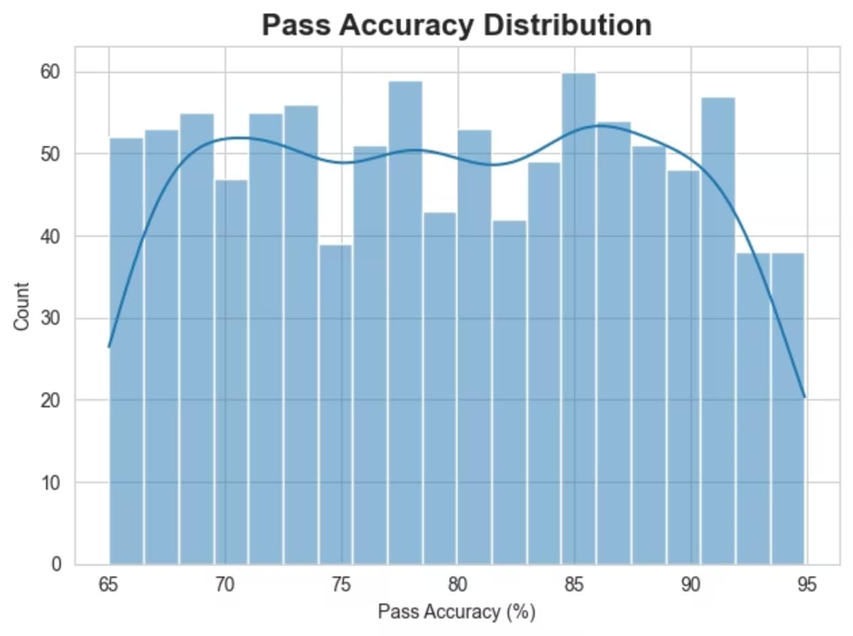
Statistical Distributions & Patterns
These distributions reveal the spread of key performance metrics across our player dataset. Goal distribution shows concentration around mid-range scorers, while pass accuracy follows a near-normal distribution centered around 80%.

Slide 9
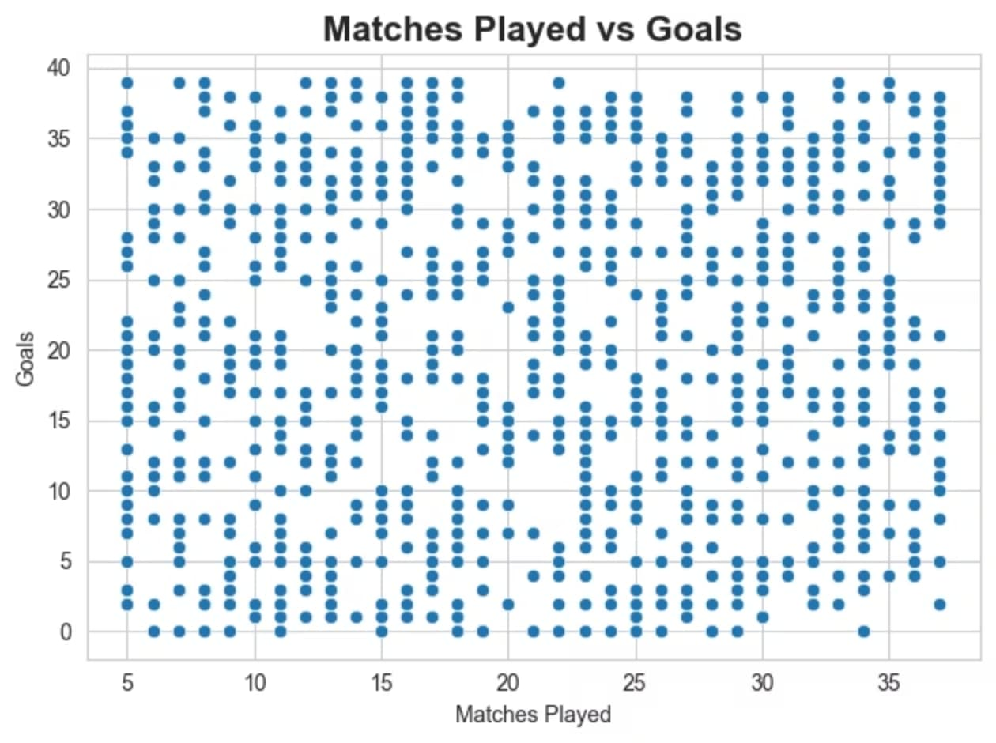
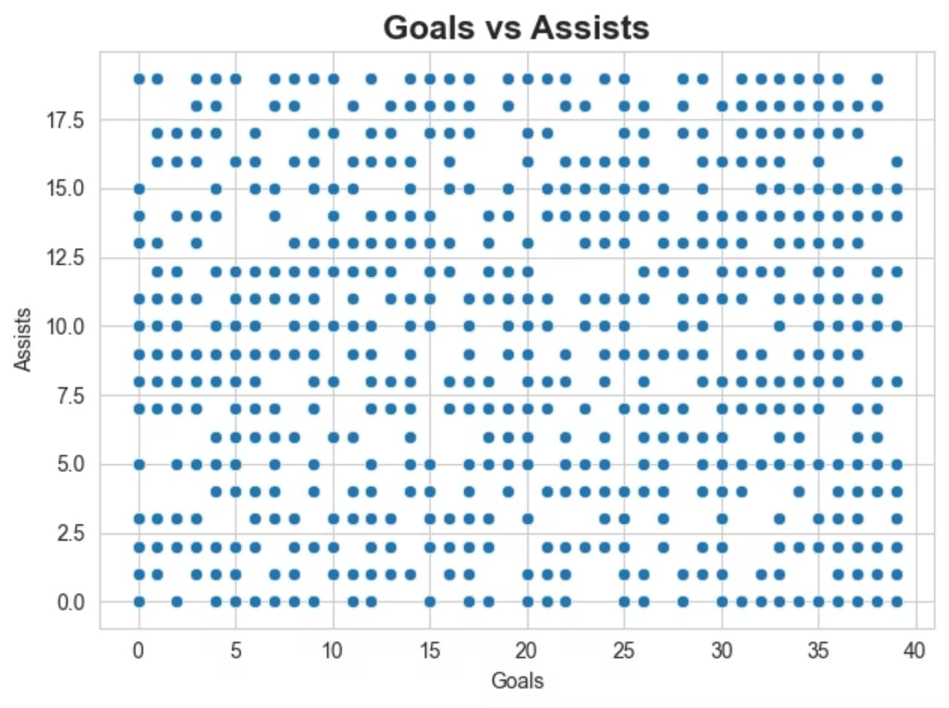
Correlation & Relationship Analysis
The correlation heatmap identifies key relationships between variables. Strong positive correlations exist between matches played and goals, and between goals and assists—validating our key insights about volume and efficiency.

Slide 10
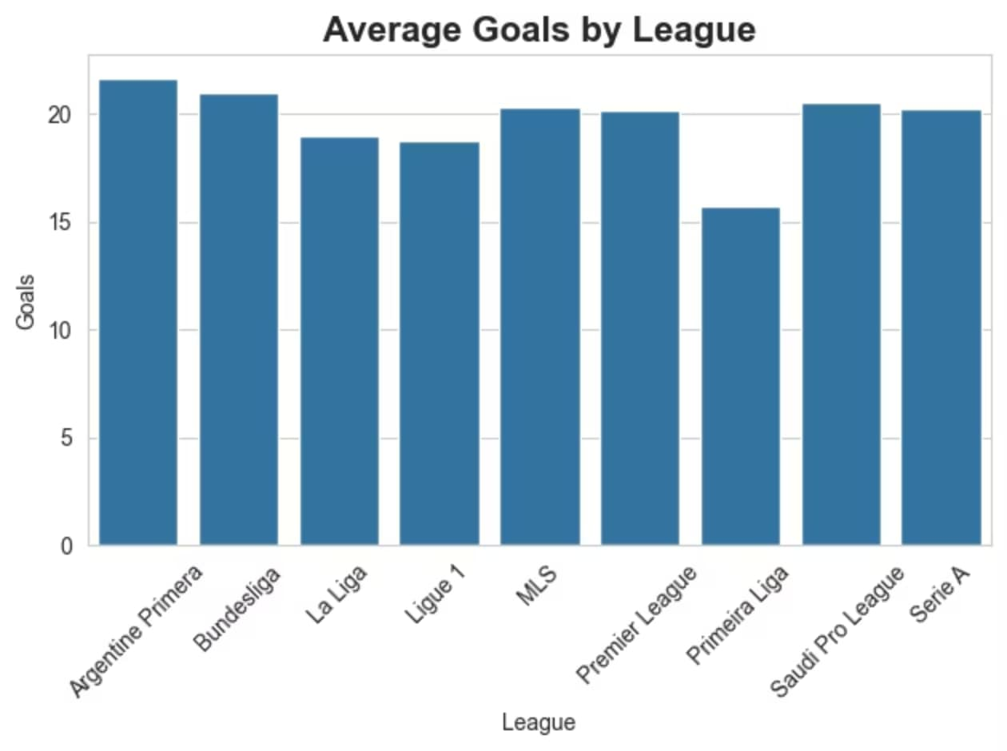
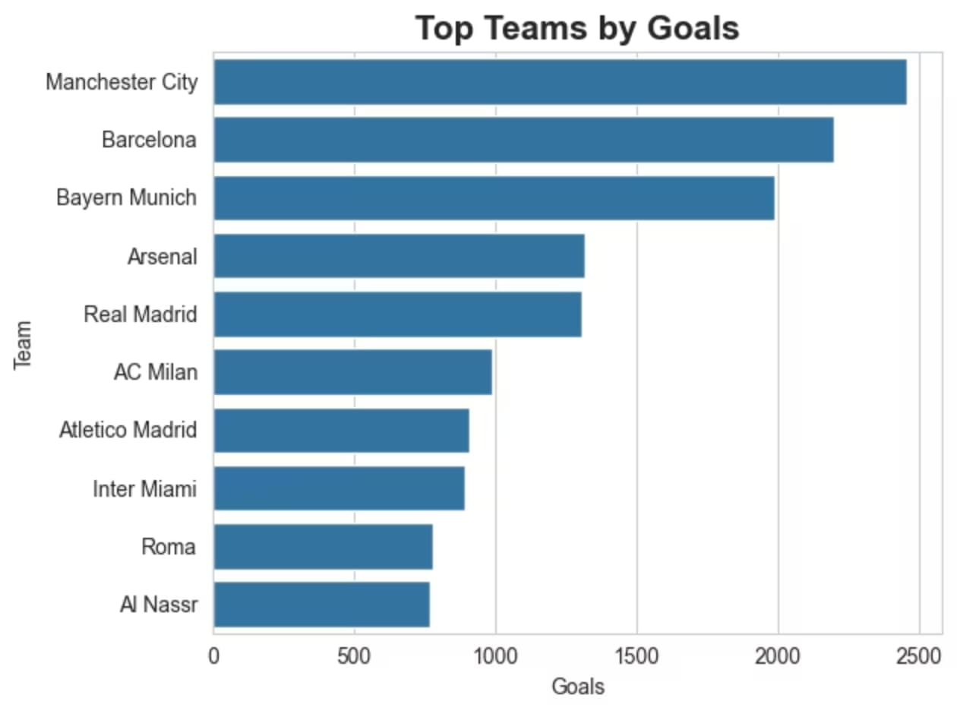
League & Team Performance Comparison
League analysis shows significant variance in average goal-scoring performance, with Argentine Primera and Bundesliga leading. Manchester City dominates in total team goals, reflecting both squad depth and tactical approach to attacking play.

Slide 11
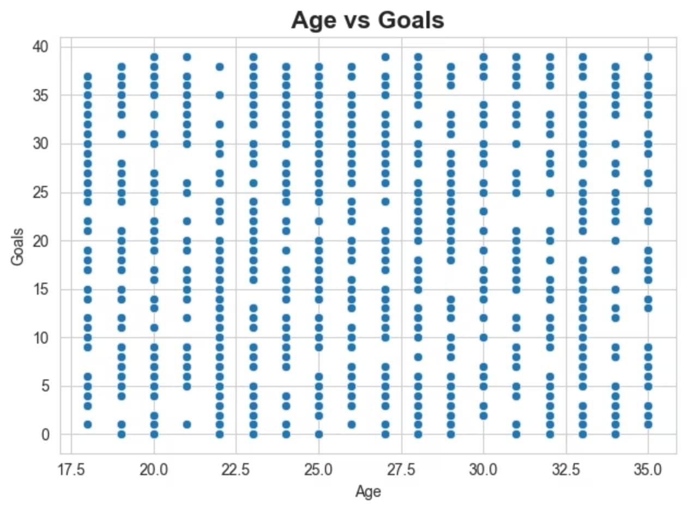
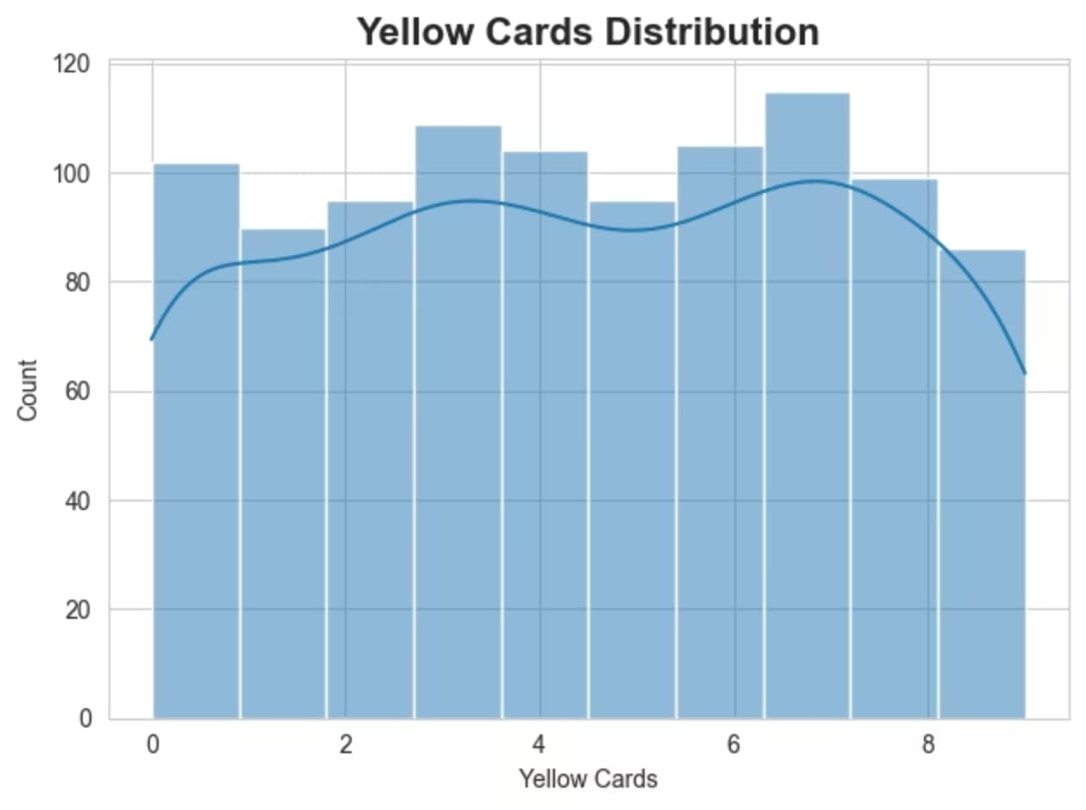
Player Demographics & Behavioral Patterns
Age analysis shows goal-scoring ability is relatively consistent across player ages (17-35), suggesting experience and youth both contribute to performance. Yellow card distribution reveals most players maintain discipline, with peak disciplinary issues around 4-5 cards per season.

Slide 12

Key Insights Revealed
Volume Drives Volume
Higher match participation correlates directly with increased goal totals
Goals-Assists Link
Strong positive correlation (r = 0.67) between goals scored and assists provided
League Variance
Performance efficiency varies significantly across different competitive leagues
Accuracy Matters
Shooting accuracy percentage strongly impacts final goal totals

Slide 13





Strategic Recommendations
Prioritize Efficiency
Improve Finishing
Focus scouting and recruitment on players with high goals-per-match ratios rather than total goals alone
Implement shooting accuracy training programs to convert more chances into goals
League-Specific Strategies
Analyze performance patterns unique to each league when making tactical decisions

Slide 14

Conclusion & Next Steps
Key Takeaways
Future Applications
Data analytics delivers actionable insights into player performance evaluation
Statistical methods reveal patterns invisible to traditional scouting
Efficiency metrics outperform raw totals in predicting future success
League context significantly impacts performance interpretation
Predictive modeling for future performance forecasting
Injury risk analysis using workload metrics
Player comparison algorithms for transfer decisions
Real-time performance tracking integration

Slide 15

Data-Driven Decisions Win Games
Football analytics transforms subjective evaluations into objective, measurable insights that drive competitive advantage

